Slide 1
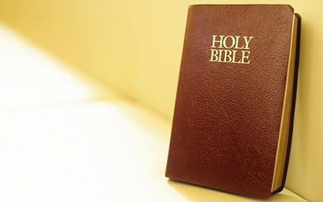
Inerrancy

Slide 2
Inerrancy: We believe the Bible, as originally written, is without any falsehood or error in what it affirms when properly interpreted.

Slide 3
Inerrancy: We believe the Bible, as originally written, is without any falsehood or error in what it affirms when properly interpreted.
This includes accurate reporting of lies and falsehoods.
Genesis 3.4 NET: [the serpent speaking] “You surely will not die.”

Slide 4
Inerrancy: We believe the Bible, as originally written, is without any falsehood or error in what it affirms when properly interpreted.
This includes common speech and literary tools like metaphor & hyperbole.
John 21.25 NET: “There are many other things that Jesus did. If every one of them were written down, I suppose the whole world would not have room for the books that would be written.”

Slide 5
Inerrancy: We believe the Bible, as originally written, is without any falsehood or error in what it affirms when properly interpreted.
This includes cultural idiosyncrasies like rounding numbers and paraphrasing.

Slide 6
Inerrancy: We believe the Bible, as originally written, is without any falsehood or error in what it affirms when properly interpreted.
All truth is from God; we just don’t understand it all yet. In the past, we have misinterpreted natural data and scriptural data.

Slide 7
Inerrancy: We believe the Bible, as originally written, is without any falsehood or error in what it affirms when properly interpreted.
We assume solutions exist for any minor contradictions. We note that many supposed contradictions which puzzled people in the past have since been resolved.

Slide 8
Why Believe in Inerrancy?
1: Theologically, we believe in God’s inspiration of Scripture.
God is without error or falsehood.
Thus, God’s Word is true.
Thus, if God inspired scripture, it must be true.
John 17.17 NASB: [Jesus praying to God the Father about his disciples:] “Sanctify them in the truth; Your word is truth.”

Slide 9
Why Believe in Inerrancy?
2: Church tradition has always been to believe in inerrancy.
Clement of Rome [1st Clement 45.2-3]:
“You have searched the Scriptures, which are true, which were given by the Holy Spirit; you know that nothing unrighteous or counterfeit is written in them.”

Slide 10
Why Believe in Inerrancy?
2: Church tradition has always been to believe in inerrancy.
Irenaeus [Against Heresies 2.28.2]:
“…[we] being most properly assured that the Scriptures are indeed perfect, since they were spoken by the Word of God and His Spirit…”

Slide 11
Why Believe in Inerrancy?
2: Church tradition has always been to believe in inerrancy.
Tertullian [Treatise on the Soul 22]:
“The statements, however, of holy Scripture will never be discordant with truth.”

Slide 12
Why Believe in Inerrancy?
2: Church tradition has always been to believe in inerrancy.
Hippolytus [Fragments on the Song of Songs 22]: “Let us mark the words of Daniel, and learn that the Scripture deals falsely with us in nothing.”

Slide 13
Why Believe in Inerrancy?
3: Reason suggests faith in Christ includes faith in the accuracy of scripture.
Alister McGrath [Christian Theology: An Introduction, 169]:
“To affirm faith in Jesus is to affirm faith in the narrative of his birth, crucifixion, death, resurrection, and ascension – a continuous story, centering upon Jesus Christ, and casting light on his identity and his significance.

Slide 14
Why Believe in Inerrancy?
4: The Bible declares itself to be inerrant.
Jesus affirmed even the most incredible parts:
Matthew 24.3-39: [Jesus speaking] “For in the days before the flood, people were eating and drinking, marrying and giving in marriage, up to the day Noah entered the ark; and they knew nothing about what would happen until the flood came and took them all away. That is how it will be at the coming of the Son of Man.”

Slide 15
Why Believe in Inerrancy?
4: The Bible declares itself to be inerrant.
Jesus fulfilled prophecies before witnesses:
Isaiah 53.5-6 NIV: “But he was pierced for our transgressions, he was crushed for our iniquities; the punishment that brought us peace was on him, and by his wounds we are healed. We all, like sheep, have gone astray, each of us has turned to our own way; and the LORD has laid on him the iniquity of us all.”

Slide 16
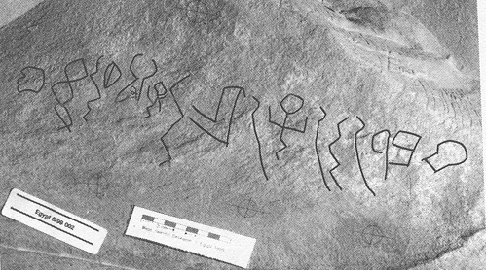
Why Believe in Inerrancy?
5: Archaeology supports scripture.
Wadi el Hol Inscription 1800BC
Photo from theglitteringeye.com

Slide 17
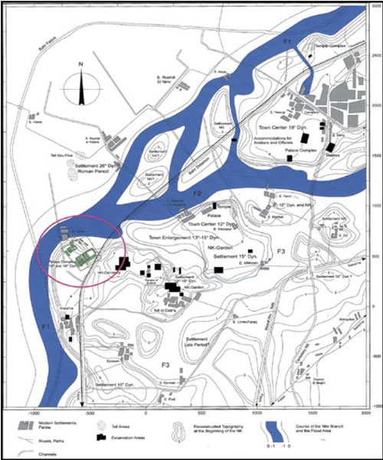
Why Believe in Inerrancy?
5: Archaeology supports scripture.
B. Tell el Daba:
Possible site for
Jewish settlement
at time of Joseph.
Photo from biblearchaeology.org

Slide 18
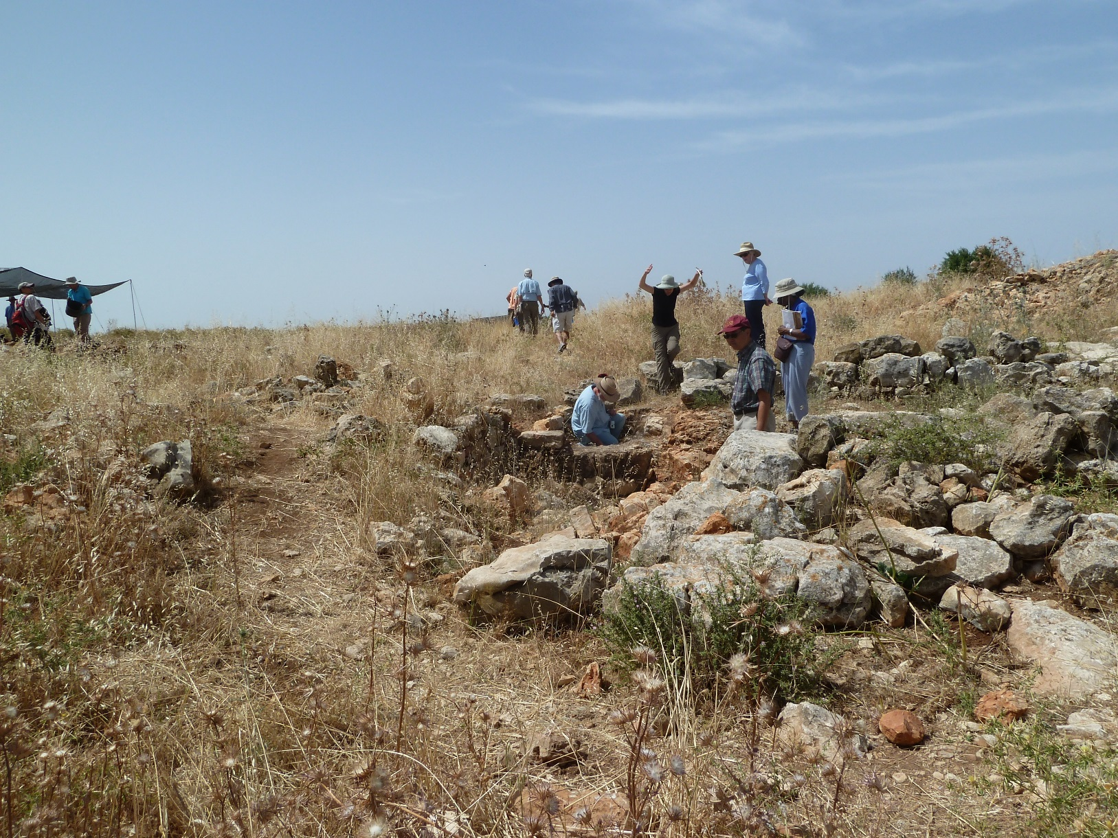
Why Believe in Inerrancy?
5: Archaeology supports scripture.
C: Khirbet el-Maqatir: Joshua’s Ai

Slide 19
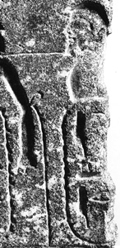
Why Believe in Inerrancy?
5: Archaeology supports scripture.
D: Pharoah’s victory pedestal
from 1400BC
Photo from biblical archaeology society

Slide 20
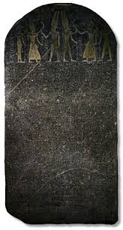
Why Believe in Inerrancy?
5: Archaeology supports scripture.
E: The Merenptah Stele
1209BC
Photo from allaboutarchaeology.org

Slide 21
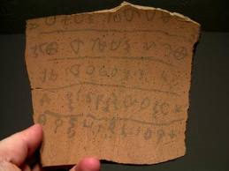
Why Believe in Inerrancy?
5: Archaeology supports scripture.
F: Khirbet Qeiyafa Inscription 1000BC
Photo from gci.org

Slide 22
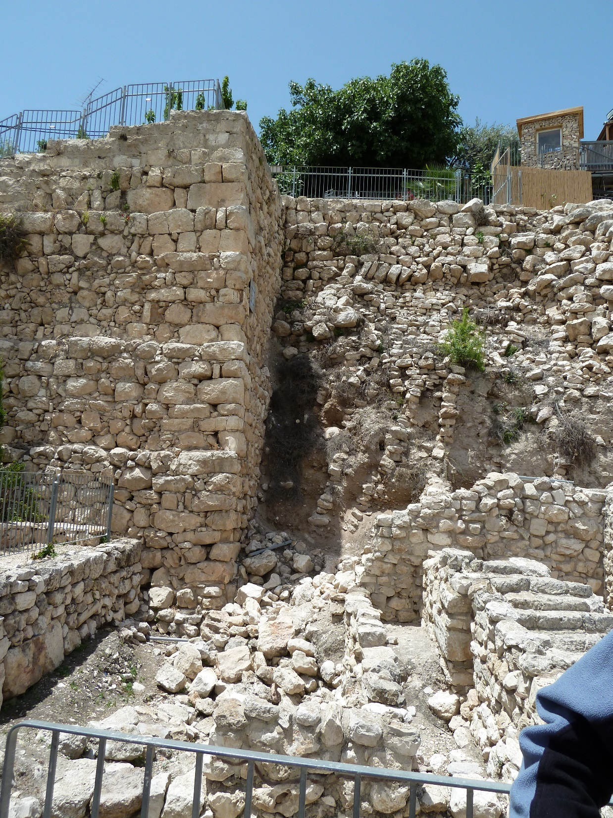
Why Believe in Inerrancy?
5: Archaeology
G: Building stones in
City of David
1000-950BC

Slide 23
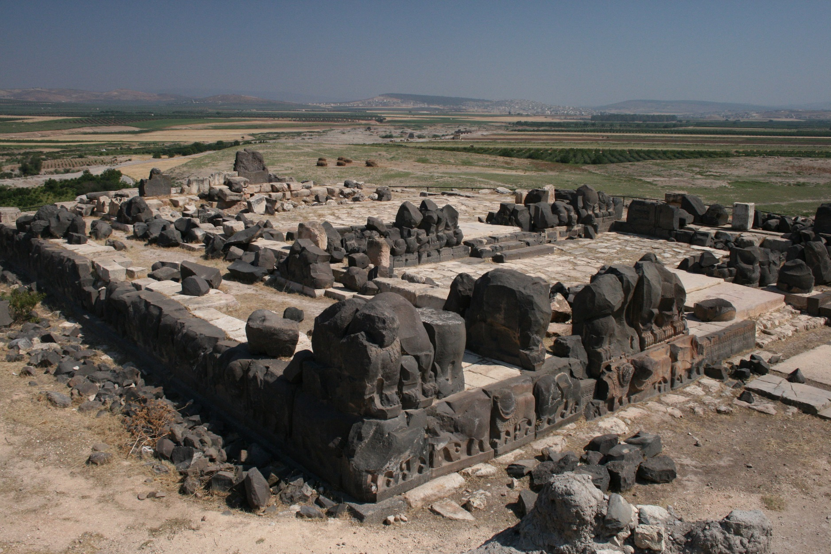
Why Believe in Inerrancy?
5: Archaeology supports scripture.
H: Ain Dara Temple 10th Century BC
Photo from gmmacdonald.wordpress.com

Slide 24
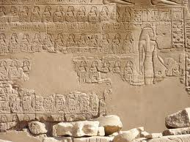
Why Believe in Inerrancy?
5: Archaeology supports scripture.
I: Bubastite Portal 10th Century BC
Photo from dlib.etc.ucla.edu

Slide 25
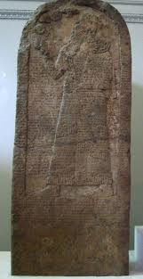
Why Believe in Inerrancy?
5: Archaeology supports scripture.
J: Kurkh Monolith
9th Century BC
Photo from jewishchristianlit.com

Slide 26
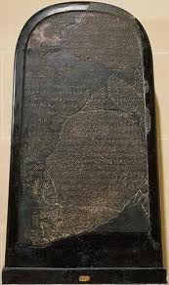
Why Believe in Inerrancy?
5: Archaeology supports scripture.
K: Mesha Stele
early 9th Century BC
Photo from bible-lands.net

Slide 27
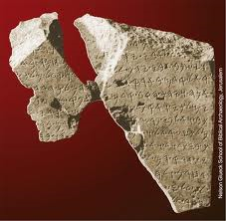
Why Believe in Inerrancy?
5: Archaeology supports scripture.
L: Tel Dan Inscription
mid-9th Century BC
Photo from biblearchaeology.org

Slide 28
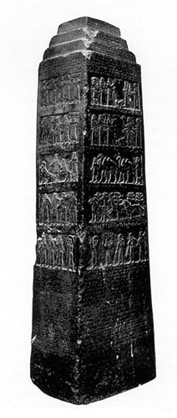
Why Believe in Inerrancy?
5: Archaeology supports
scripture.
M: Black Obelisk
9th Century BC
Photo from bible-history.com

Slide 29
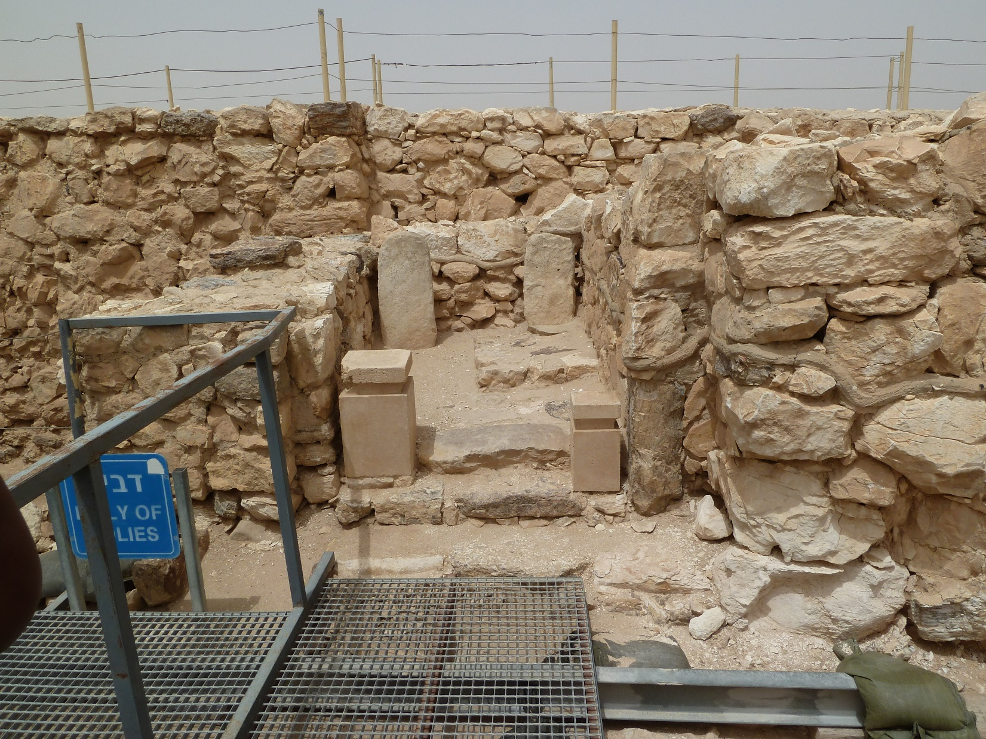
Why Believe in Inerrancy?
5: Archaeology supports scripture.
N: Worship Alter at Arad mid-9th Century BC

Slide 30
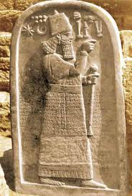
Why Believe in Inerrancy?
5: Archaeology supports scripture.
O: Tell al Rimah Stele
800BC
Photo from biblearchaeology.org

Slide 31
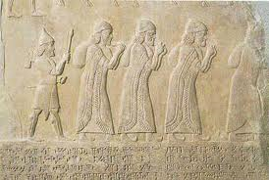
Why Believe in Inerrancy?
5: Archaeology supports scripture.
P: Tiglah Pileser III’s annals 8th Century BC
Photo from people.bethel.edu

Slide 32
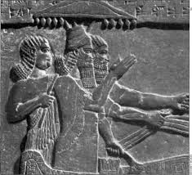
Why Believe in Inerrancy?
5: Archaeology supports scripture.
Q: Tiglah Pileser III’s Summary Inscription
8th Century BC
Photo from galaxie.com

Slide 33
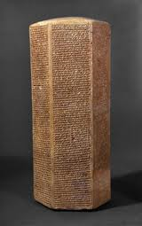
Why Believe in Inerrancy?
5: Archaeology
R: Annals of Sennacherib
7th Century BC
Photo from cojs.org

Slide 34
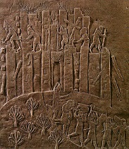
Why Believe in Inerrancy?
5: Archaeology
S: Writings of
Esarhaddon &
Ashurbanipal
7th Century BC
Photo from newworldencyclopedia.org

Slide 35
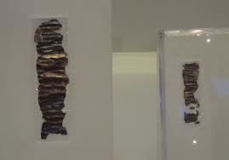
Why Believe in Inerrancy?
5: Archaeology supports scripture.
T: The Katef Hinnom silver scrolls 6th-7th C. BC
Photo from en.wikipedia.org

Slide 36
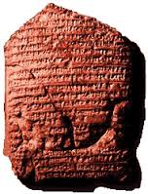
Why Believe in Inerrancy?
5: Archaeology supports scripture.
U: Babylonian Chronicle
6th Century BC
Photo from bible-history.com

Slide 37
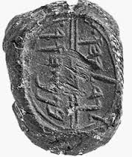
Why Believe in Inerrancy?
5: Archaeology supports scripture.
W: Jerusalem seals
6th Century BC
Photo from biblearchaeology.org

Slide 38
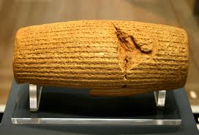
Why Believe in Inerrancy?
5: Archaeology supports scripture.
V: Cyrus Cylinder 6th Century BC
Photo from bible-history.com

Slide 39
Why Believe in Inerrancy?
5: Archaeology supports scripture.
1600 BC
1500 BC
1400 BC
1300 BC
1200 BC
1100 BC
1000 BC
900 BC
800 BC
700 BC
600 BC
500 BC
400 BC
End of OT history

Slide 40
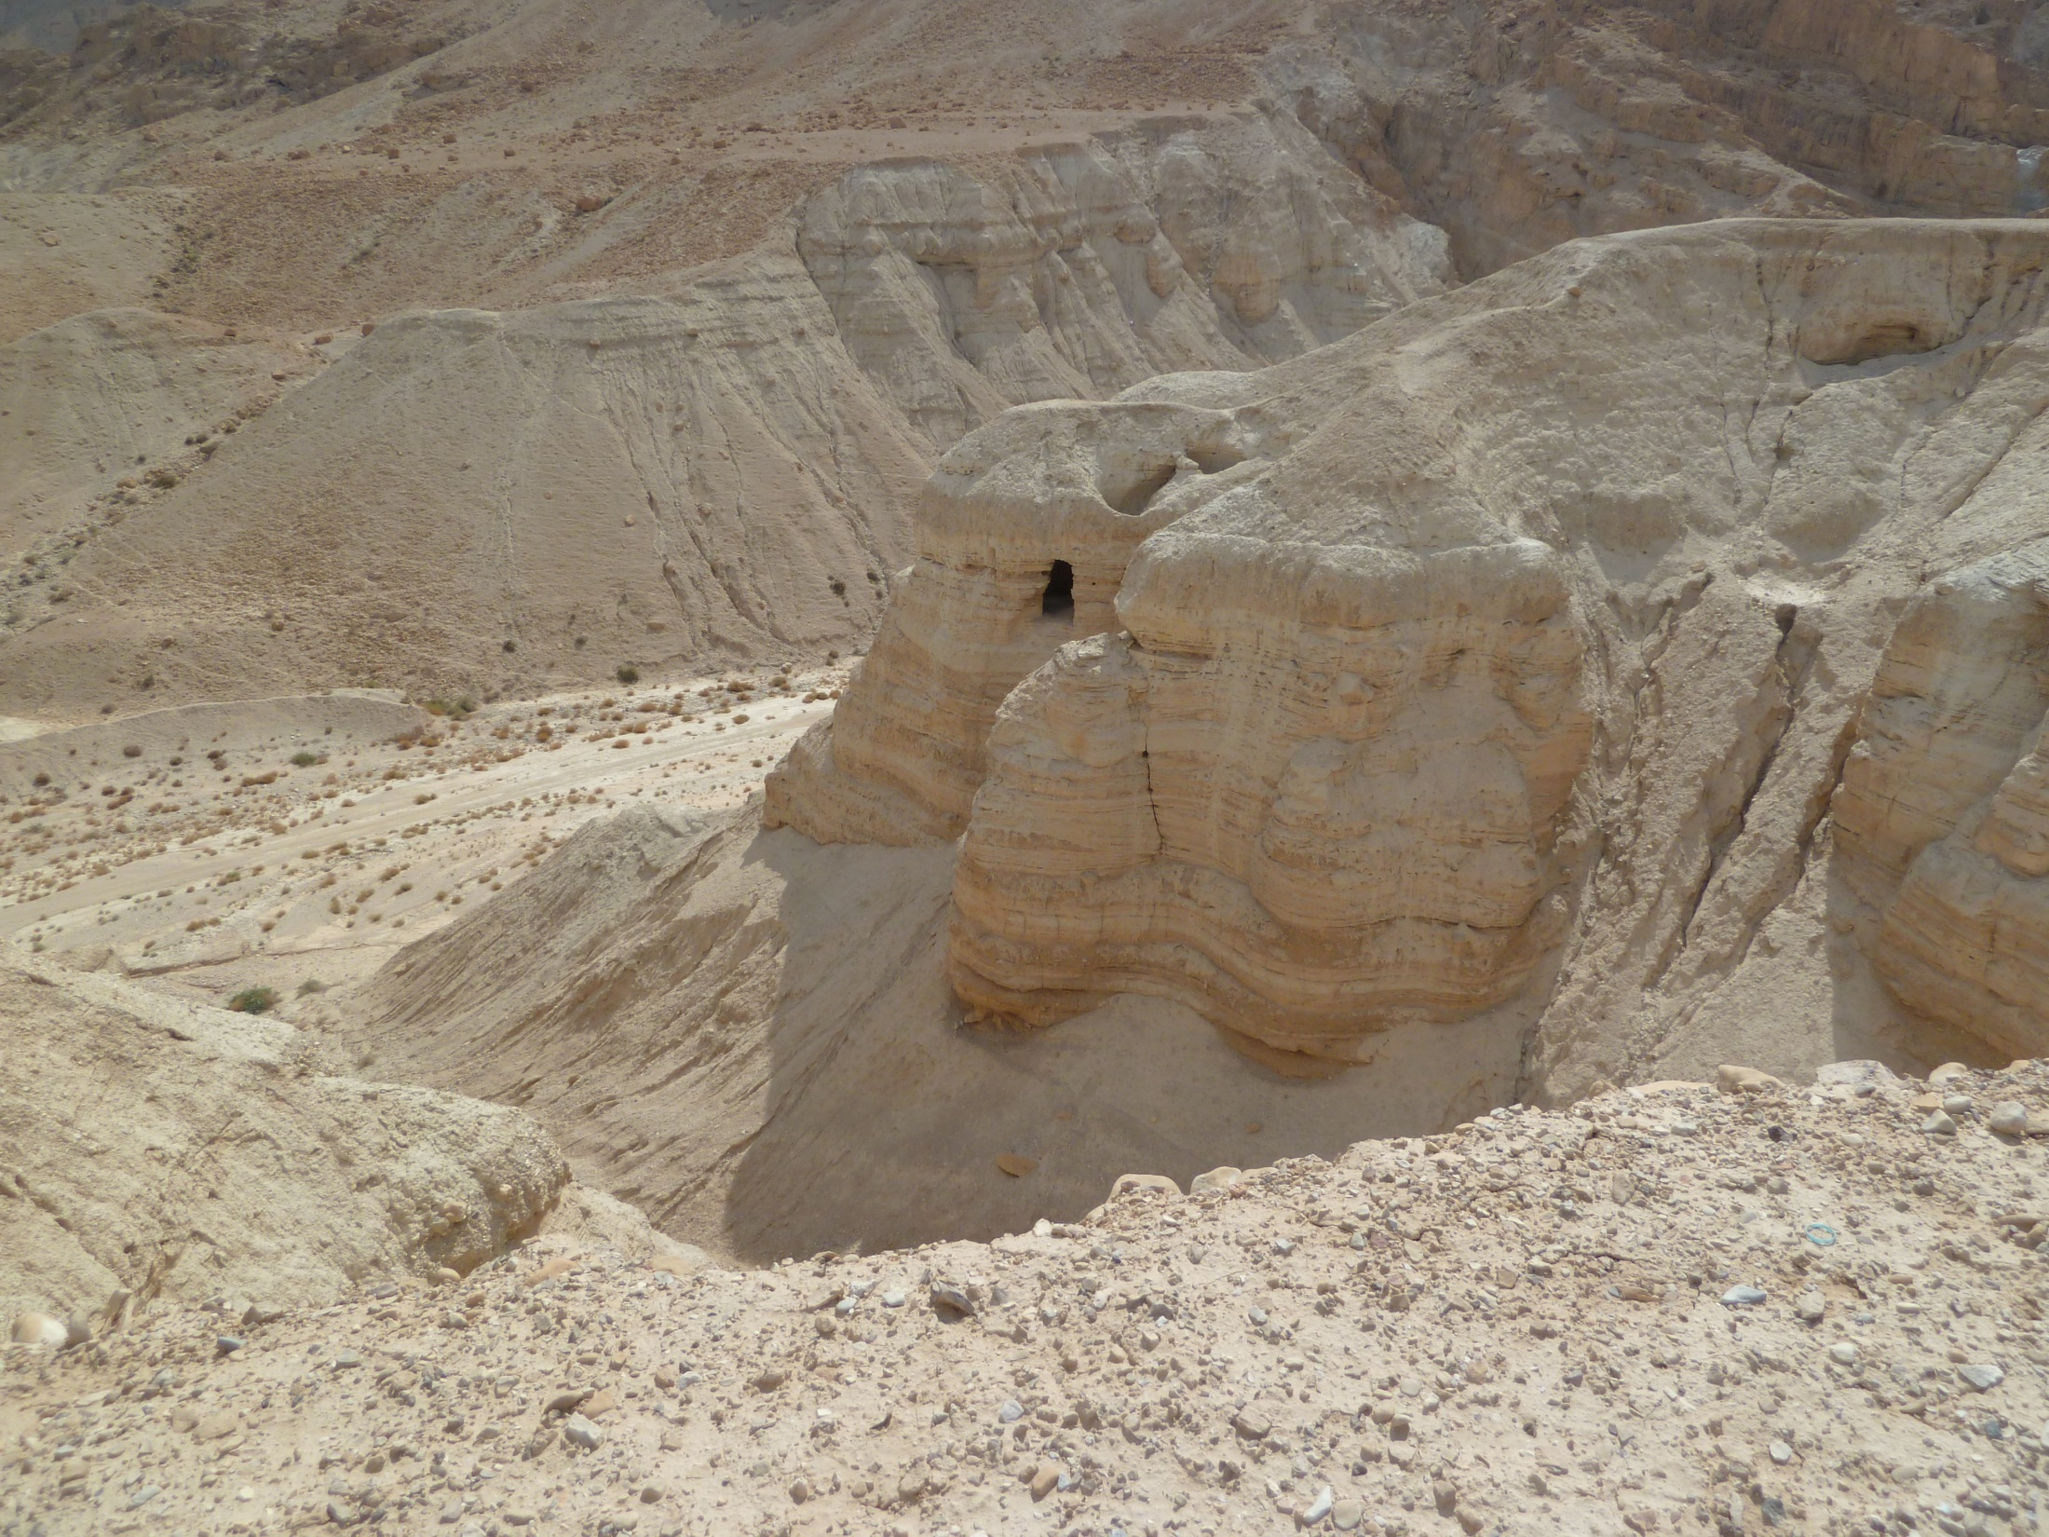
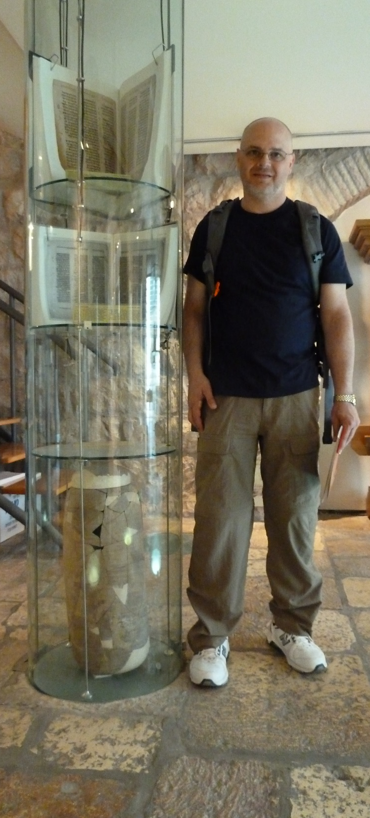
Cave
Scroll Jar

Slide 41
If we believe the Bible is inspired and inerrant revelation from God…
…how should we respond?

Slide 42
Resources:
Hendricks & Hendricks: Living by the Book
Ryken: How to Read the Bible as Literature
Anders: 30 Days to Understanding the Bible
Wilkinson & Boa: Talk thru the Bible
Steinmann: From Abraham to Paul

